Slide 1


TEAM MEMBERS
Nithya B
Oviya K
Pavithra R
Shubashini J

Slide 2
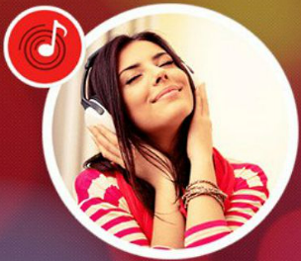

Wynk Music App Development Using Flutter
Introduction :
A Wynk Music clone is a music streaming platform inspired by Wynk Music, offering users access to a vast library of songs across various genres.
It typically includes features like personalized playlists, curated recommendations, offline listening, and easy navigation.
The clone aims to replicate Wynk Music's functionality and user experience, providing an alternative option for music enthusiasts to discover, stream, and enjoy their favorite tracks conveniently.

Slide 3
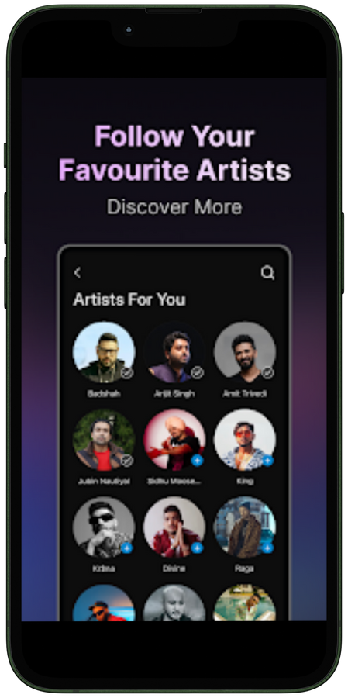
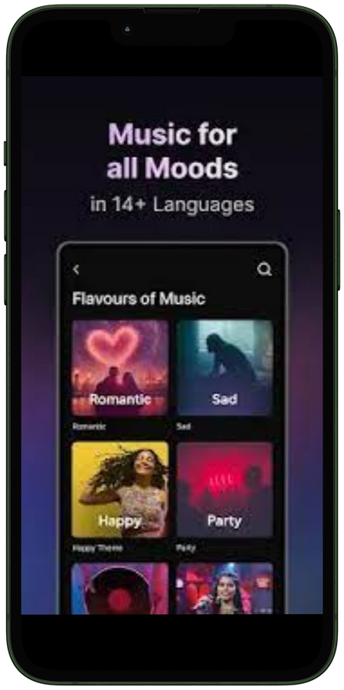
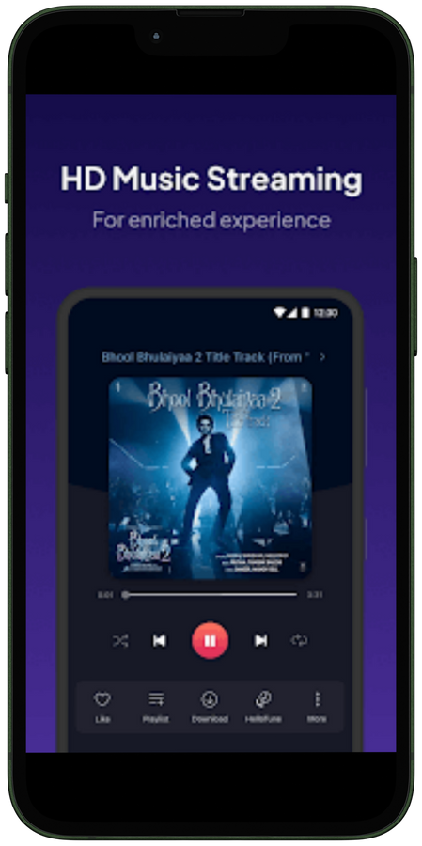
Mission

Slide 4

Benefits
Vast Music Library: Access to a vast collection of songs spanning various languages, genres, and artists, ensuring users can find music to suit their preferences.
Curated Playlists: Enjoy curated playlists curated by music experts, making it easier to discover new music or enjoy a seamless listening experience.
Personalized Recommendations: Receive personalized song recommendations based on listening history and preferences, helping users discover new tracks tailored to their tastes.
Offline Listening: Download songs for offline listening, allowing users to enjoy their favorite music even without an internet connection, ideal for situations like traveling or areas with poor connectivity.

Slide 5
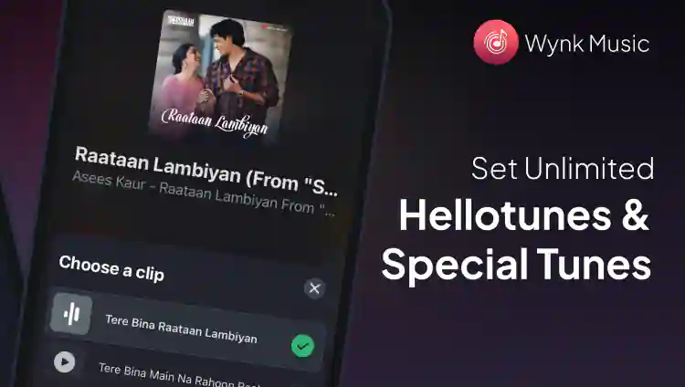
Value Proposition :
1.Vast Music Library: Access to a vast and diverse library of songs spanning multiple languages, genres, and artists, ensuring users can find music that suits their tastes and preferences.
2.Personalization: Utilizing advanced algorithms, Wynk Music provides personalized recommendations and curated playlists based on users' listening history, preferences, and mood, enhancing the discovery of new music and creating a tailored listening experience.
3.Seamless User Experience: Wynk Music offers an intuitive and user-friendly interface across various platforms, including mobile devices, desktops, and smart TVs, ensuring a seamless and enjoyable user experience.
4.Offline Listening: The ability to download songs for offline listening enables users to enjoy their favorite music even without an internet connection, enhancing convenience and accessibility, particularly in areas with limited connectivity or during travel.

Slide 6
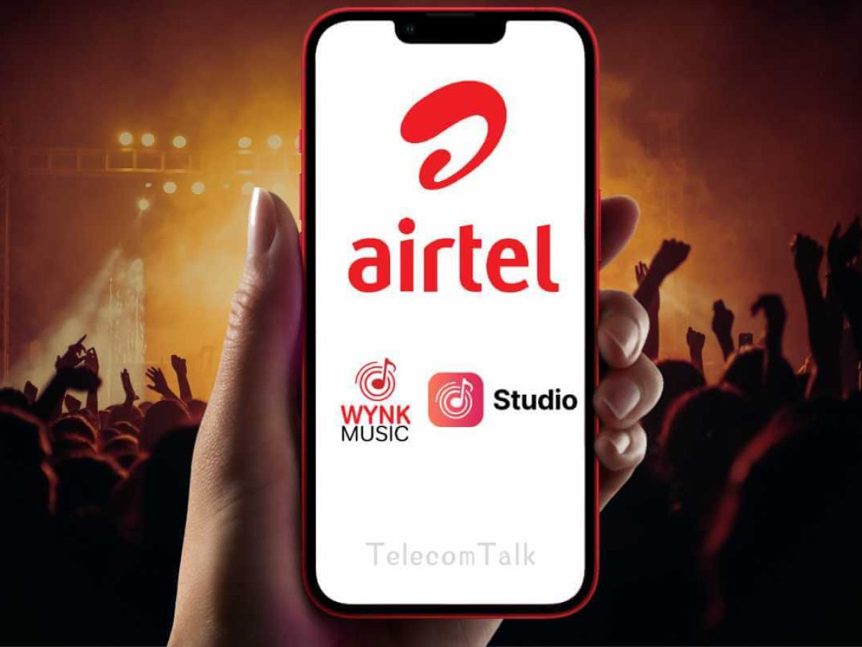


OPERATION MANAGEMENT
Content Management: Acquiring, organizing, and maintaining a vast library of songs across various genres and languages.
Platform Maintenance: Ensuring the smooth functioning and optimization of the Wynk Music platform across different devices and operating systems.
Personalization Algorithms: Developing and refining algorithms to provide personalized recommendations and curated playlists based on user preferences and behavior.
Technical Infrastructure: Managing the technical infrastructure, including servers, databases, and network systems, to ensure uninterrupted streaming and download services

Slide 7
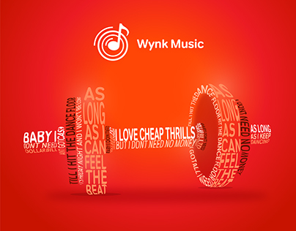


Specific indicators
Premium in Wynk MUsic
BUT IF YOU ARE AIRTEL SUBSCRIBER, the obvious choice would be Wynk Music. You get more bands (Spotify is currently stuck in a pickle with Warner Music- so no Linkin Park, Green Day, etc.) and a direct route to set up hello tunes. In a nutshell, its all about your preferences.1
BUT IF YOU ARE AIRTEL SUBSCRIBER, the obvious choice would be Wynk Music. You get more bands (Spotify is currently stuck in a pickle with Warner Music- so no Linkin Park, Green Day, etc.) and a direct route to set up hello tunes. In a nutshell, its all about your preferences.1
Objectives achieved
Advantages
BUT IF YOU ARE AIRTEL SUBSCRIBER, the obvious choice would be Wynk Music. You get more bands (Spotify is currently stuck in a pickle with Warner Music- so no Linkin Park, Green Day, etc.) and a direct route to set up hello tunes. In a nutshell, its all about your preferences.1
BUT IF YOU ARE AIRTEL SUBSCRIBER, the obvious choice would be Wynk Music. You get more bands (Spotify is currently stuck in a pickle with Warner Music- so no Linkin Park, Green Day, etc.) and a direct route to set up hello tunes. In a nutshell, its all about your preferences.1

Slide 8
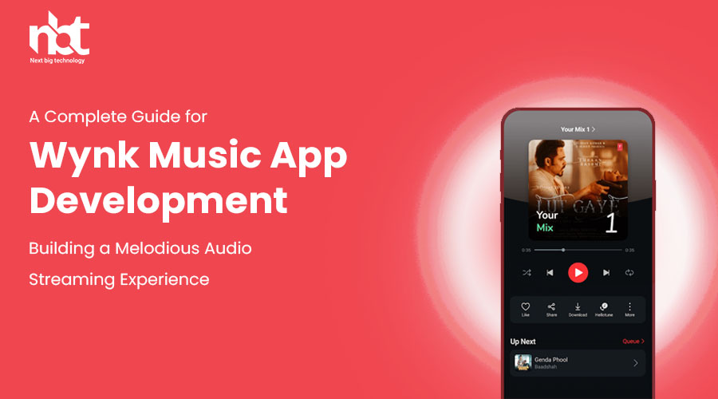

Slide 9
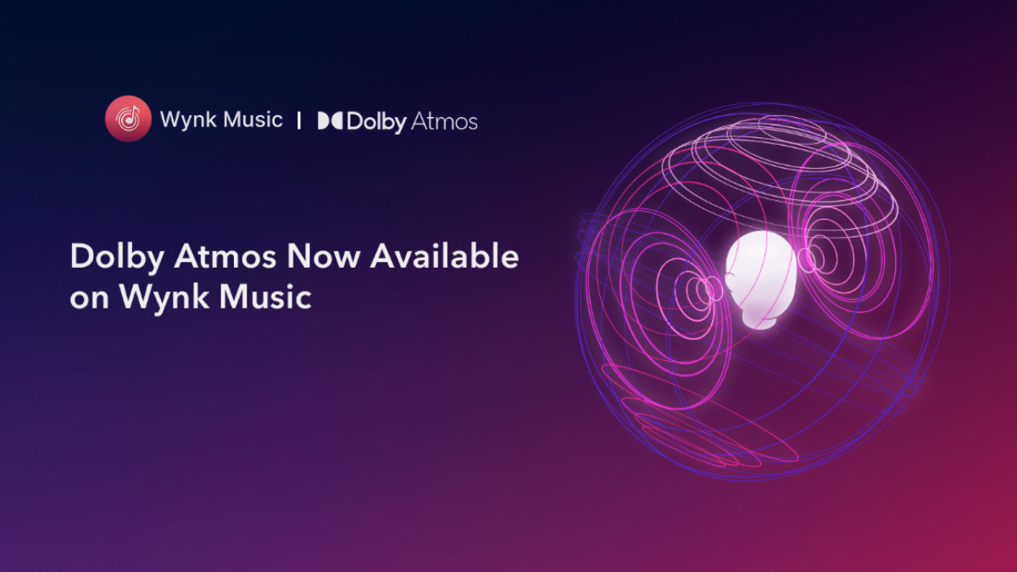
Future goals
Compose an original song.
Learn a new song every week.
Branch out and try learning a new instrument.
Learn a new style or genre, or explore improvisation.
Create a press kit for your band, or update your musical resume if you're a soloist.

Slide 10
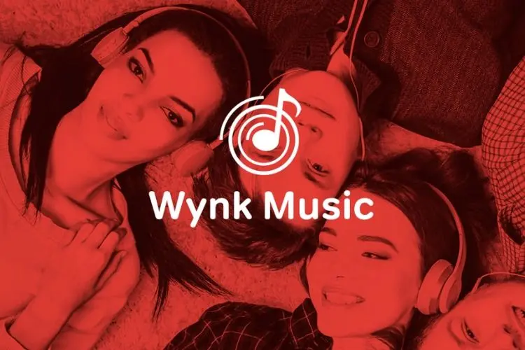
Thank you...

